Slide 1
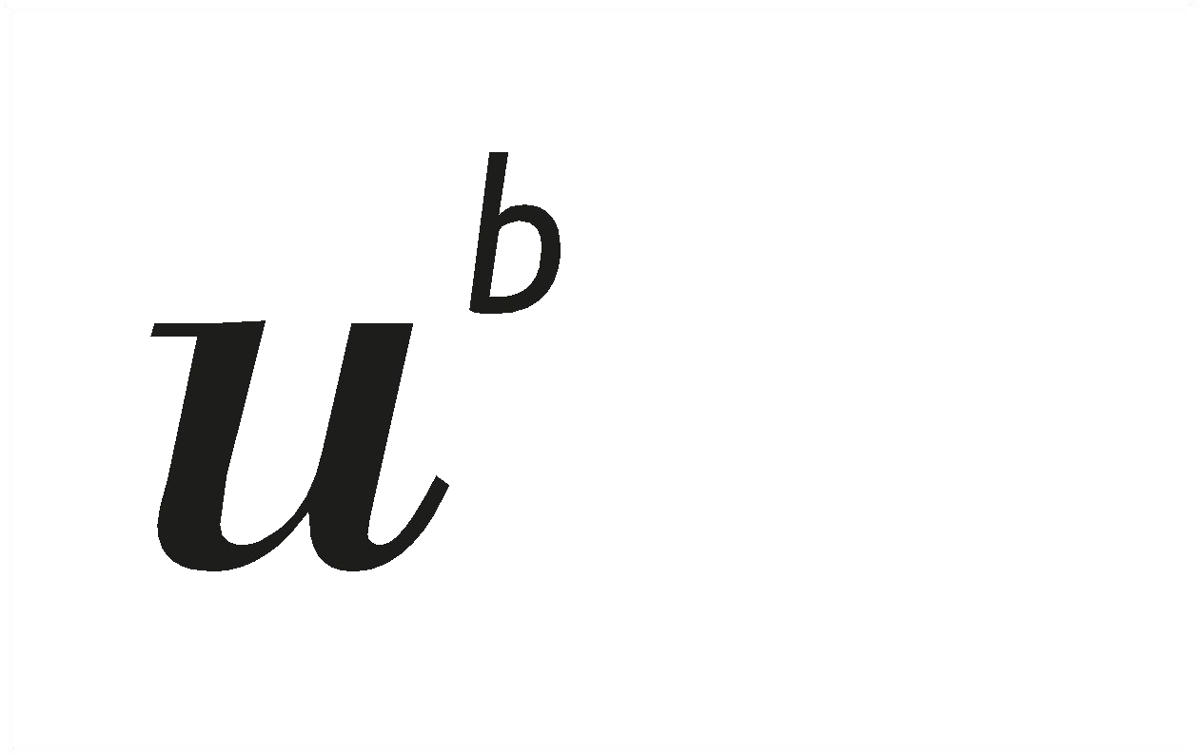
Gene Expression Data and Hypothesis Testing

Slide 2
Experiment
As an engineer with little interest in biology, I found myself frustrated at the outset of analyzing the given data. My initial goal was to demonstrate statistical methods I had learned, but without a clear hypothesis or understanding of the data’s context, running meaningful analyses felt like a challenge.
However, as I delved deeper and interpreted each result, the picture gradually became clearer. I began to see value in the tests, as they revealed relationships between the parameters and how they influence one another.
The key takeaway: statistics can be engaging and insightful, but only when you know what you're trying to prove. As data scientists, it's crucial to understand the purpose behind statistical analysis.
This experience has been an experiment in how a data scientist can adapt to and analyze data outside their expertise. Whether I’ve succeeded or not—that’s for you to judge.

Slide 3
Gene expression regulation and Statistical Tests
Gene expression regulation is the process by which cells control when, how much, and where specific genes are expressed. This regulation ensures that genes are turned on or off as needed, which allows cells to respond to their environment, differentiate into specialized types, and maintain normal function.
Key Concepts of Gene Expression Regulation:
Gene Expression: The process of converting information from a gene into a functional product, usually a protein, but it can also be RNA.
Regulation: Controlling this process to ensure that the right genes are expressed in the right cells, at the right time, and in the correct amount.
Why is Gene Expression Regulation Important?
It allows cells to adapt to changing environmental conditions.
It helps in the development of multicellular organisms by ensuring different cell types express specific sets of genes.
It prevents the unnecessary production of proteins, saving cellular resources and energy.
Misregulation can lead to diseases such as cancer, where genes involved in cell growth are improperly regulated.
In this study we try To analyse the relationships between gene expression, mRNA stability, and protein synthesis, potentially revealing how cells regulate these processes in different tissues or environments. These insights are crucial for understanding fundamental biological mechanisms and could be used in areas like disease research or drug development.
The comparisons and statistical analyses should provide valuable insights into gene behaviour under different conditions.
Understanding Gene Regulation: compare gene behavior (e.g., mRNA stability or protein translation efficiency) across different conditions or gene sets.
Identifying Functional Subgroups: comparing significant vs. non-significant genes based on localization or other factors
Supporting Biological Hypotheses: statistical evidence to support hypotheses about gene regulation, such as whether genes with certain regulatory elements (like AREs) have different half-lives or are translated more efficiently.
Gene expression regulation is crucial for controlling which genes are active in a cell at any given time. It occurs at multiple levels, from transcription to protein activity, and is essential for the development, adaptation, and survival of an organism. Proper regulation is key to normal cellular function, and disruptions can lead to disease.

Slide 4
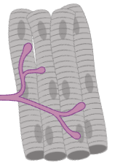
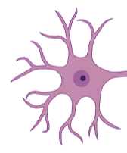

The dataset come from a study related to RNA degradation and stability. The described below parameters are collected in 13 different samples with their corresponding half-life and Location in the cell (soma, neurites or other) It includes gene_id: unique identifier for a gene. (name is also included) loc_var: Describes whether the location is significant or not. (soma, neurites or other) hl: represent half-life (the time it takes for the gene's mRNA to degrade). m6A enriched m6A consensus enrichment data m6A enriched/depleted or Not significant ARE: Adenylate-Uridylate Rich Elements, control mRNA stability tAI: tRNA Adaptation Index, a measure of how efficiently tRNAs can translate into protein TPU.length: the length of translated protein units
Overview of provided Data
Cell body
Neurite
The ARE and tAI variables relate to post-transcriptional and translational regulation.
AREs are known to control mRNA stability, influencing how long mRNA stays in the cell and is available for translation into protein.
tAI affects how efficiently the mRNA is translated based on tRNA availability, which is crucial for controlling protein production levels.
~ 25 μm
up to 1 meter
Data: distribution of mRNA half-lives (hl) in different parts of neuronal cells: cell bodies (=soma) and extensions (=neurites).
The mRNA half-life is the time required for the concentration of a specific mRNA molecule in a cell to decrease by half due to degradation processes. how long an mRNA molecule or Protein lives in cells before it’s degraded, measured in hours.

Slide 5
Overview of provided Data
an analogy using cars to represent the parameters in the dataset:
1. Gene Half-Life (hl) = Car Longevity (Car Lifespan)
Gene half-life represents how long an mRNA remains stable before it degrades. In cars, this could be represented by how long a car lasts (its lifespan) before it breaks down or becomes unusable.
Example: A car with a long lifespan (e.g., 300,000 miles) is like a gene with a long half-life—both stay functional for a long time.
2. m6A Enrichment (m6a.cons.enrich) = Fuel Efficiency Technology (A+ or B or F)
m6A enrichment is a modification that influences how efficiently an mRNA is processed or degraded. In cars, this could be represented by fuel efficiency technology (e.g., hybrid engines or electric vehicles more efficient than normal gas).
Example: A car with cutting-edge fuel efficiency tech is like a gene with m6A enrichment—it operates in a special, efficient way, potentially giving it an edge in performance or cost-effectiveness.
3. Adenylate-Uridylate Rich Elements (ARE) = Car’s Maintenance Needs (how many times it breaks down)
AREs control the stability of mRNA, often making it degrade faster. In cars, this is like how frequently a car needs maintenance or repairs.
Example: A car with many issues or a high maintenance schedule represents a gene with high ARE presence—it won’t last as long without frequent breakdowns.
4. tRNA Adaptation Index (tAI) = Fuel Compatibility
tAI measures how efficiently tRNAs can translate the mRNA into protein. In cars, this is like how compatible a car’s engine is with different fuel types (e.g., premium, regular, diesel).
Example: A car with a high tAI (fuel flexibility) can run efficiently on diff types of fuel, just like a gene with a high tAI is efficiently translated into protein.
5. TPU Length (Translated Protein Unit Length) = Car Size (Capacity)
TPU length refers to the size of the protein being produced. In cars, this could be like the size or capacity of the car (e.g., compact car vs. SUV).
Example: A gene with a long TPU is like an SUV—it requires more time and resources to build. A gene with a short TPU is like a compact car—quicker and easier to produce.

Slide 6
Overview of provided Data
Putting it All Together:
Let’s say we have three cars (genes):
Car A (Gene A): (mini copper)
Longevity (Lifespan): 150,000 miles (shorter lifespan, half-life ~2 years)
Fuel Efficiency Tech (m6A): Standard (Not significant m6A enrichment)
Maintenance Needs (ARE): Low maintenance (Few AREs)
Fuel Compatibility (tAI): Works well only with premium fuel (Low tAI)
Size (TPU): Compact car (Short TPU)
Interpretation: This car has a moderate lifespan, doesn’t require much maintenance, but needs special fuel (low tAI). It’s small and doesn’t take much time to produce. This could represent a gene with standard regulation, producing a small protein but having specific requirements for translation.
Car B (Gene B): (Mercedes G Wagen)
Longevity (Lifespan): 300,000 miles (long lifespan, long half-life)
Fuel Efficiency Tech (m6A): Advanced hybrid engine (High m6A enrichment)
Maintenance Needs (ARE): High maintenance (Many AREs)
Fuel Compatibility (tAI): Runs on any fuel (High tAI)
Size (TPU): Large SUV (Long TPU)
Interpretation: This car is highly efficient, has a long lifespan, but needs frequent maintenance (like high AREs affecting mRNA stability). It’s very adaptable to different fuels, and it produces a large protein that takes longer to make, but overall is highly functional.
Car C (Gene C): (VW passat)
Longevity (Lifespan): 100,000 miles (short lifespan, short half-life)
Fuel Efficiency Tech (m6A): No special tech (No m6A enrichment)
Maintenance Needs (ARE): Moderate maintenance (Moderate AREs)
Fuel Compatibility (tAI): Works only with diesel (Low tAI)
Size (TPU): Mid-size sedan (Medium TPU)
Interpretation: This car has a shorter lifespan, moderate maintenance needs, and requires a specific type of fuel (low tAI). It produces a medium-sized protein but isn’t as efficient as other models.
The cars represent different genes, and the parameters (like half-life, m6A enrichment, AREs, tAI, and TPU length) affect their "performance" and efficiency, much like how a car’s features (longevity, fuel efficiency, maintenance needs) influence its functionality.

Slide 7
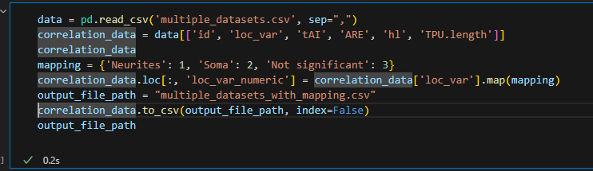
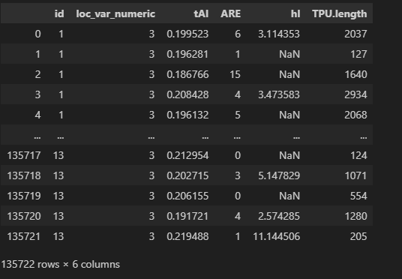
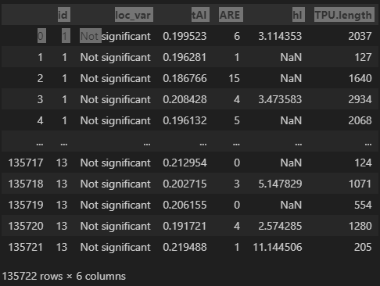
Overview of provided Data
Independent variable: loc_var {'Neurites': 1, 'Soma': 2, 'Not significant': 3}
Dependent variables: tAI, ARE, hl, TPU.length
Other important columns: id (dataset identifier), localisation, gene_id, dataset_loc

Slide 8
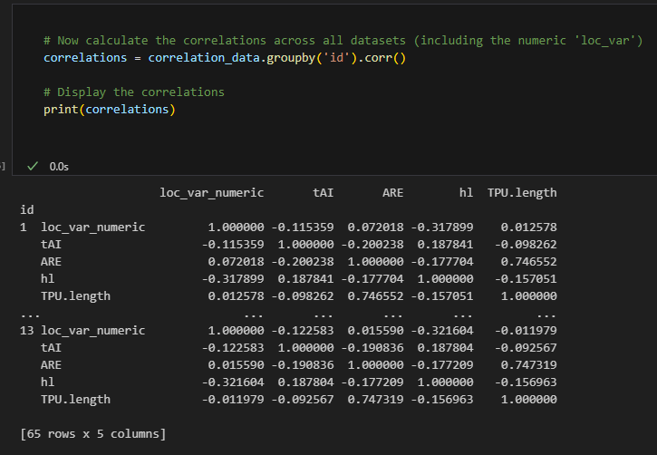
DATA Correlation
explore correlations between:
loc_var (independent) with the dependent variables across different datasets (id from 1 to 13).
OR Dependent variables between each other for specific datasets.
Correlation Coefficient: A value that ranges from -1 to 1:
1: Perfect positive correlation (when one variable increases, the other also increases).
0: No correlation (there is no linear relationship between the variables).
-1: Perfect negative correlation (when one variable increases, the other decreases).
0.7466 (ARE and TPU.length): Strong positive correlation, indicating that genes with more AREs tend to have longer proteins.
-0.3179 (loc_var_numeric and hl): Weak negative correlation, suggesting a slight inverse relationship between localization and gene half-life.
0.1878 (tAI and hl): Weak positive correlation between translation efficiency and mRNA stability.
-0.1154 (loc_var_numeric and tAI): Weak negative correlation between localization variance and translation efficiency.
Diagonal values are always 1.0, because they represent the correlation of a variable with itself
Off-diagonal values show the strength and direction of the relationship between two variables.

Slide 9
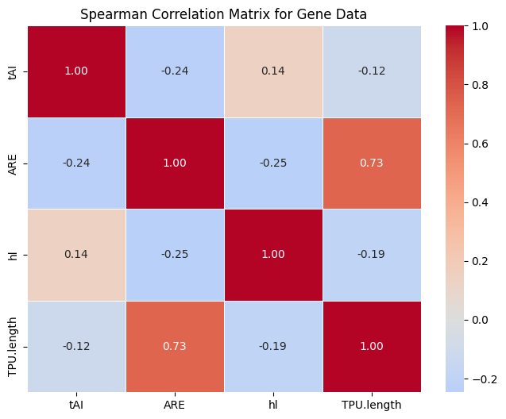
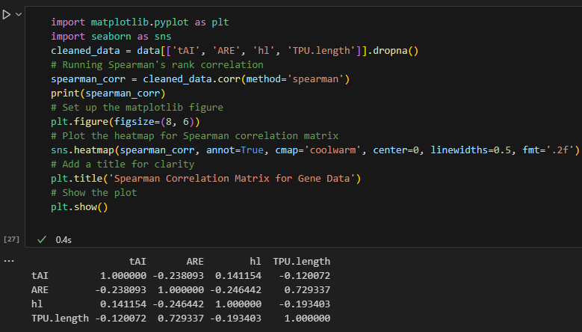
Spearman Correlation Matrix
ARE and TPU length:
0.73 — A strong positive correlation, indicating that as the ARE increases, TPU length increase.
ARE and hl (half-life):
−0.25 — A moderate negative correlation, suggesting that as ARE increases, the half-life decrease.
tAI and ARE:
−0.24 — A moderate negative correlation, meaning that as tAI increases, ARE tends to decrease.
hl and TPU length:
−0.19 — A weak negative correlation between half-life and TPU length.
Diagonal values are always 1.0, because they represent the correlation of a variable with itself
Off-diagonal values show the strength and direction of the relationship between two variables.

Slide 10
Hypothesis Tests for Half life
Hypothesis 0: Are there any normally distributed parameter
Hypothesis 1: Location Affects mRNA Half-Life
Hypothesis: The half-lives of mRNAs differ significantly between genes expressed in soma and neurites.
Test:Mann-Whitney U Test: A non-parametric test to compare half-lives between soma and neurites
Hypothesis 2: ARE Presence Affects mRNA Half-Life
Hypothesis: Genes containing ARE elements will have shorter half-lives compared to those without AREs.
Test:Mann-Whitney U Test: Compare the half-lives of genes with and without AREs.
Hypothesis 3: Effects of ARE presence, tAI, and TPU length.
Hypothesis: Half-life is influenced by a combination of variables, such as ARE presence, tAI, and TPU length.
Test:Mann-Whitney U Test: Compare the half-lives of genes with and without AREs.
Test:Kruskal-Wallis statistic test for each ARE presence, tAI, and TPU length
Hypothesis 4: Combined Effects of ARE presence, tAI, and TPU length.
Hypothesis: Half-life is influenced by a combination of variables, such as ARE presence, tAI, and TPU length.
Test:Kruskal-Wallis statistic test combination of variables, such as ARE presence, tAI, and TPU length

Slide 11
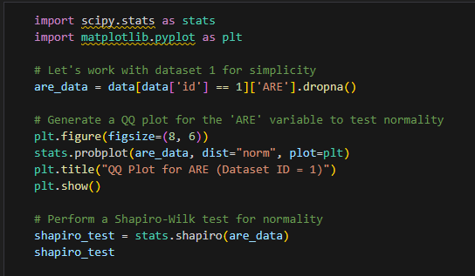
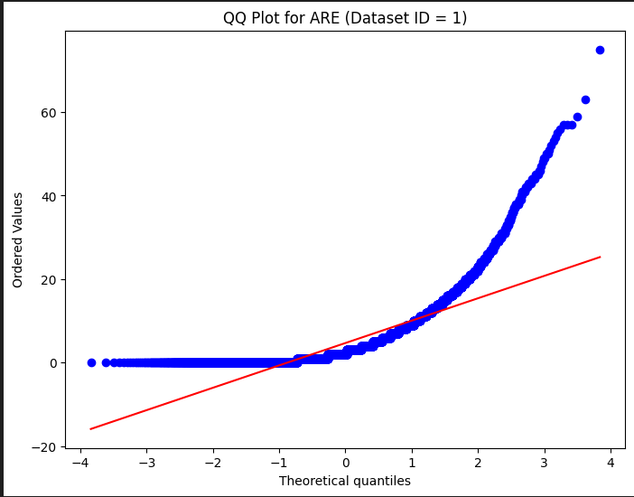
Hypothesis 0: Normally distributed and QQ Plot
Let's hypothesize that the distribution of one of the dependent variables, for example, ARE, follows a normal distribution for dataset id = 1
Null Hypothesis (H₀): The variable ARE follows a normal distribution.
Alternative Hypothesis (H₁): The variable ARE does not follow a normal distribution.
Test the Hypothesis: QQ plot (quantile-quantile plot) to visually assess the normality of ARE and then apply a formal normality test (Shapiro-Wilk or Kolmogorov-Smirnov test) to verify it.
Visually, the points deviate significantly from the expected line of a normal distribution, which suggests non-normality.
Shapiro-Wilk Test Results:Test Statistic: 0.7087,p-value: 0.0
Conclusion:
Given the extremely low p-value (below 0.05), we reject the null hypothesis. This indicates that the distribution of ARE does not follow a normal distribution.

Slide 12
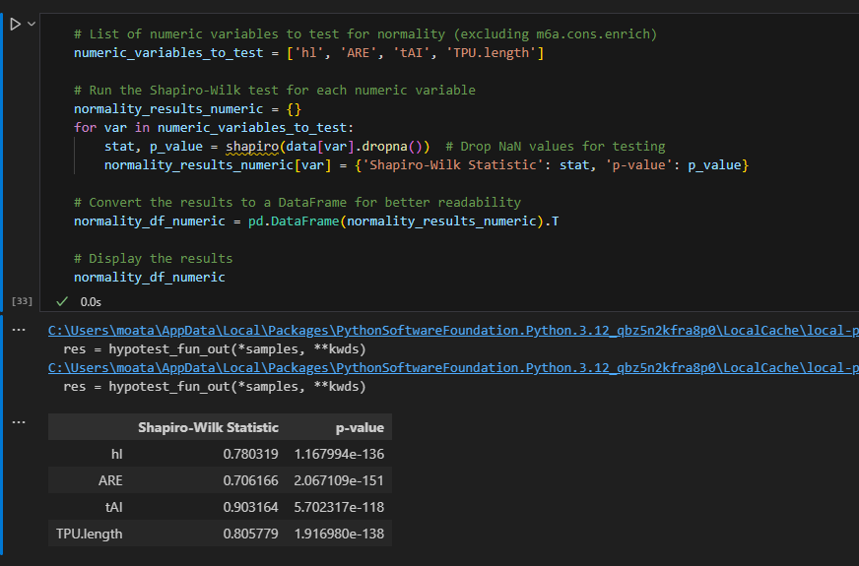
Hypothesis 0: is any parameter Normally distributed
Hypothesis: all the available data are normally distributed
Null Hypothesis (H₀): all the available data are normally distributed
Alternative Hypothesis (H₁): The variable ARE does not follow a normal distribution.
We run he Shapiro-Wilk test for all parameters to see If any of them are normally distributed
For all parameters , the p-values are 0.0, which indicates that none of these variables follow a normal distribution. we reject the null hypothesis
This confirms that non-parametric tests (like Spearman’s correlation or Mann-Whitney U tests) are more appropriate for analyzing these variables.

Slide 13
not normally distributed = non-parametric tests
Mann-Whitney U Test Statistic (U)
Definition: The Mann-Whitney U statistic is a measure of the difference between two independent groups. It ranks all the observations from both groups together and then sums the ranks for each group. The U statistic reflects the number of times observations from one group precede observations from the other group in the ranked list.
Null Hypothesis (H₀): the null hypothesis typically states that there is no difference in the distributions of the two groups.
Alternative Hypothesis (H₁): there is difference in the distributions of the two groups.
large U value indicates a substantial difference in the ranking distributions between the two groups
Very small p-value : The p-value assesses the strength of the evidence against the null hypothesis.
A p-value extremely close to zero indicates that the observed difference between the 2 groups is highly statistically significant.
We would reject the null hypothesis with high confidence and confirm there is difference between the two groups.
to Determine the Direction: Calculate the Median for Each Group and the one having higher median correlate positively while the other negatively
The Kruskal-Wallis statistic is a non-parametric method for testing extension of the Mann-Whitney U test for comparing more than two independent groups. It is often used when the data does not meet the assumptions of normality
Null Hypothesis (H₀): the null hypothesis typically states that there is no significant difference between the groups
Alternative Hypothesis (H₁): at least one group is significantly different from the others.
p-value is small (typically less than 0.05), you can reject the null hypothesis,

Slide 14
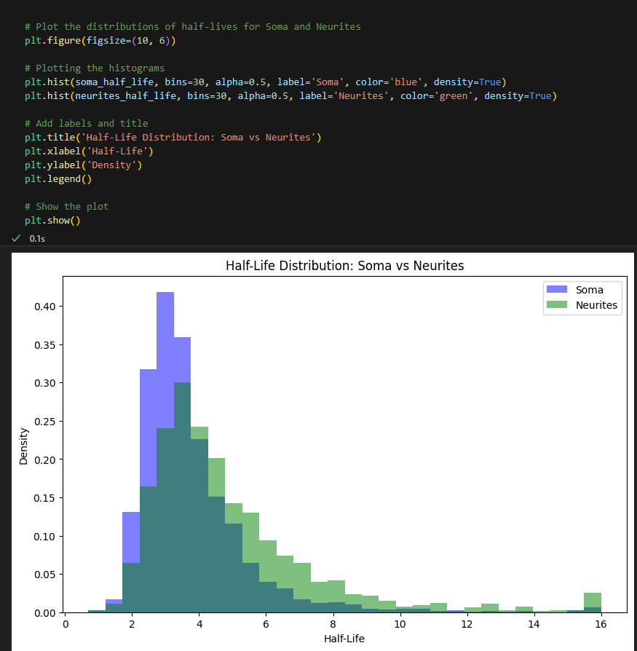
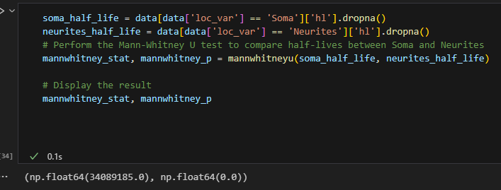
Hypothesis 1: Location Affects mRNA Half-Life
Null Hypothesis (H₀): the null hypothesis states that The half-lives of mRNAs does not differ between genes expressed in soma and neurites.
Alternative Hypothesis (H₁): The half-lives of mRNAs differ significantly between genes expressed in soma and neurites.
The Mann-Whitney U test results for comparing the half-lives of genes in Soma and Neurites are as follows:
Test statistic: 34,089,185.0
p-value: 0.0 significantly lower than (0.05)
This result suggests that the distribution of half-lives is different between these two locations.
we Accept the Alternative hypothesis

Slide 15
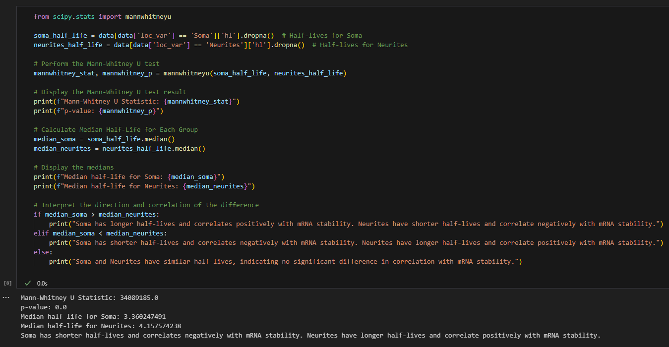
Hypothesis 1: Location Affects mRNA Half-Life
Soma has shorter half-lives and correlates negatively with mRNA stability.
Neurites have longer half-lives and correlate positively with mRNA stability.

Slide 16
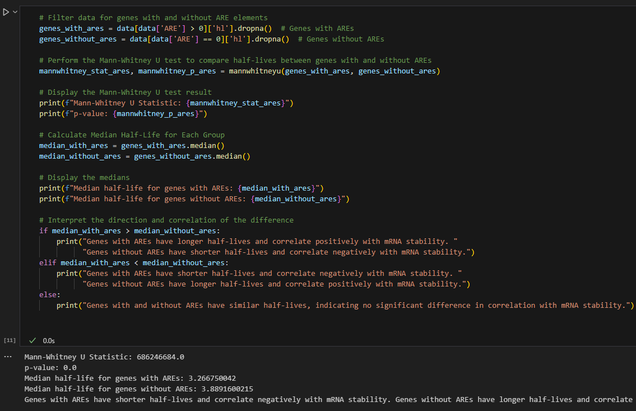
Hypothesis 2: ARE Presence Affects mRNA Half-Life
Reject null hypothesis that there is no difference between the 2 groups
Since hl median with ARE is smaller
Genes with AREs have shorter half-lives and correlate negatively with mRNA stability.
Genes without AREs have longer half-lives and correlate positively with mRNA stability.

Slide 17
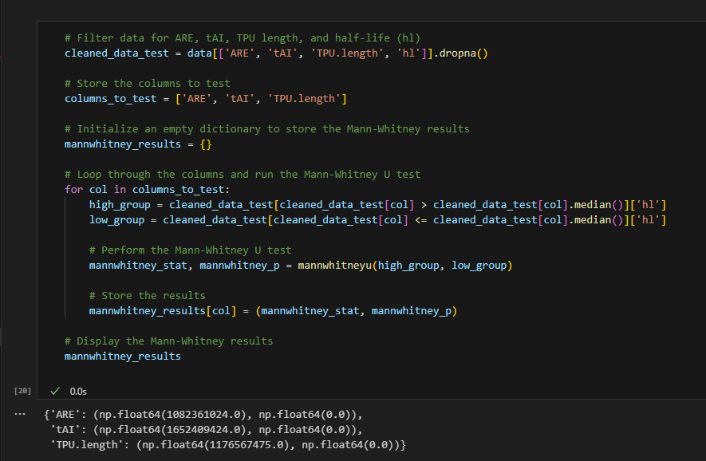
Hypothesis 3: Effects of ARE , tAI, TPU length
For each factor (ARE, tAI, and TPU length), the Mann-Whitney test produced:
ARE:
If the p-value is low, it suggests that genes with high ARE (presence of ARE) tend to have significantly different mRNA half-lives compared to genes with low ARE (absence of ARE).
A low p-value here might indicate that AREs significantly influence mRNA stability, making mRNAs degrade faster or slower.
tAI (tRNA Adaptation Index):
A low p-value would indicate that there is a significant difference in mRNA half-lives between genes with high tAI (optimal codon usage for available tRNAs) and low tAI (non-optimal codon usage).
This could suggest that codon optimization affects how long mRNAs are stable, with efficient translation potentially leading to differences in mRNA degradation rates.
TPU Length:
A significant p-value means that genes with long TPU (translated protein unit) lengths have significantly different mRNA half-lives compared to genes with shorter TPU lengths.
This might reflect how longer proteins take longer to translate, which could either stabilize or destabilize the mRNA depending on cellular conditions.

Slide 18
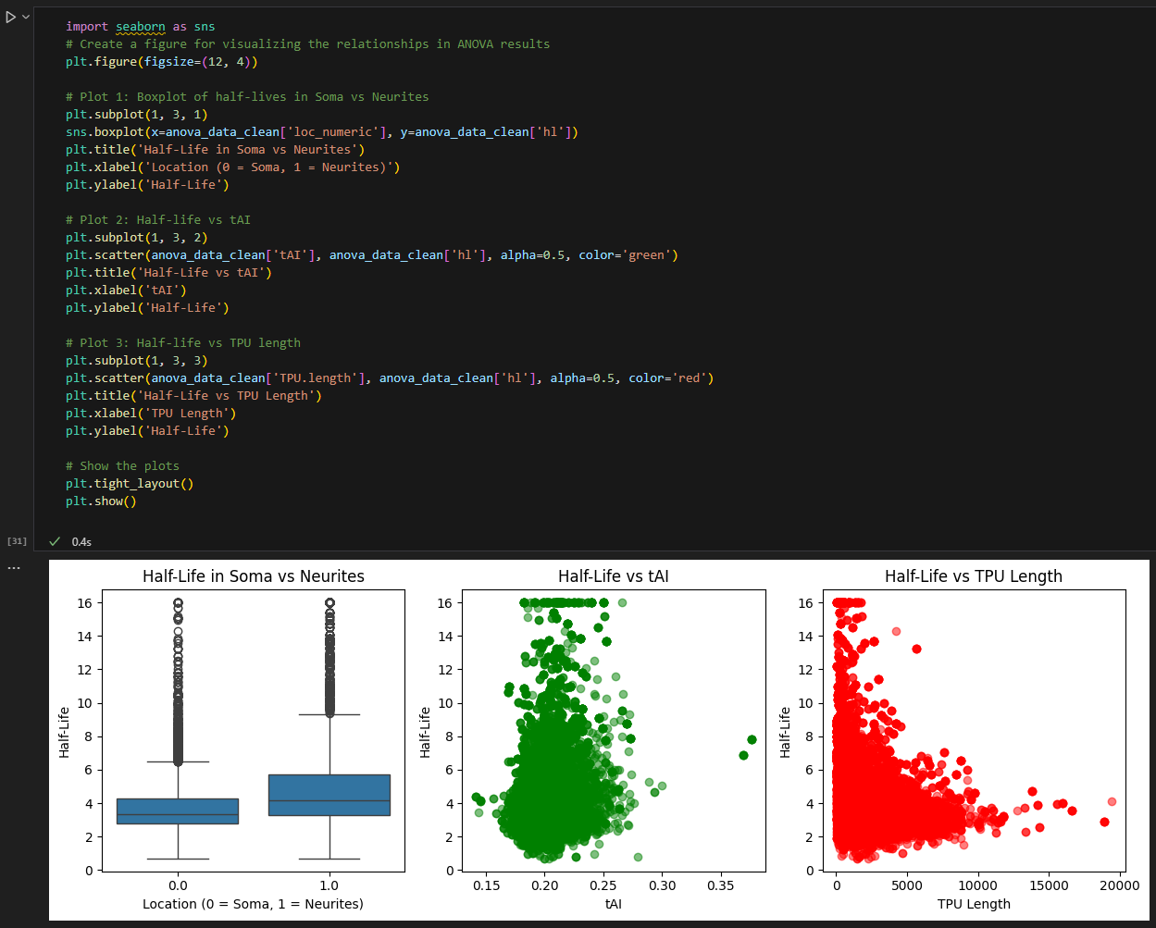
Hypothesis 3: Effects of ARE , tAI, and TPU length.
Half-Life in Soma vs Neurites: The box plot shows that genes expressed in neurites tend to have longer half-lives compared to those in soma. The median half-life is visibly higher in neurites.
Half-Life vs tAI: There is a positive relationship between tAI (translation efficiency) and half-life, with higher tAI values associated with longer half-lives.
Half-Life vs TPU Length: The plot suggests that as TPU length increases, half-life generally decreases, but the effect size is small, as observed in the regression analysis.
These visualizations align with the earlier results, showing how these factors influence mRNA half-life.

Slide 19
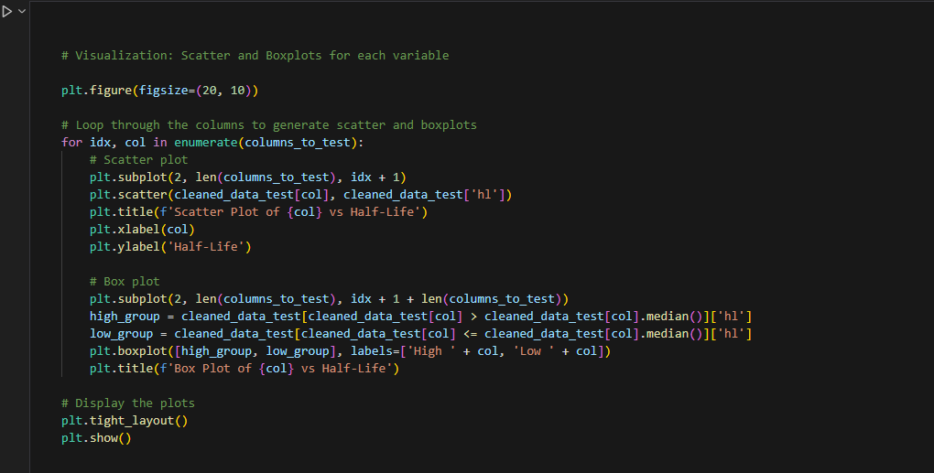
Hypothesis 3: Effects of ARE , tAI, and TPU length.

Slide 20
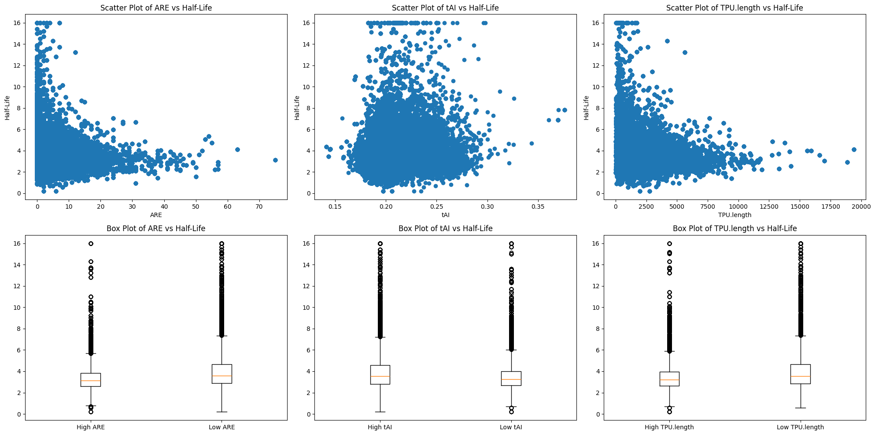
Hypothesis 3: Effects of ARE , tAI, and TPU length.

Slide 21
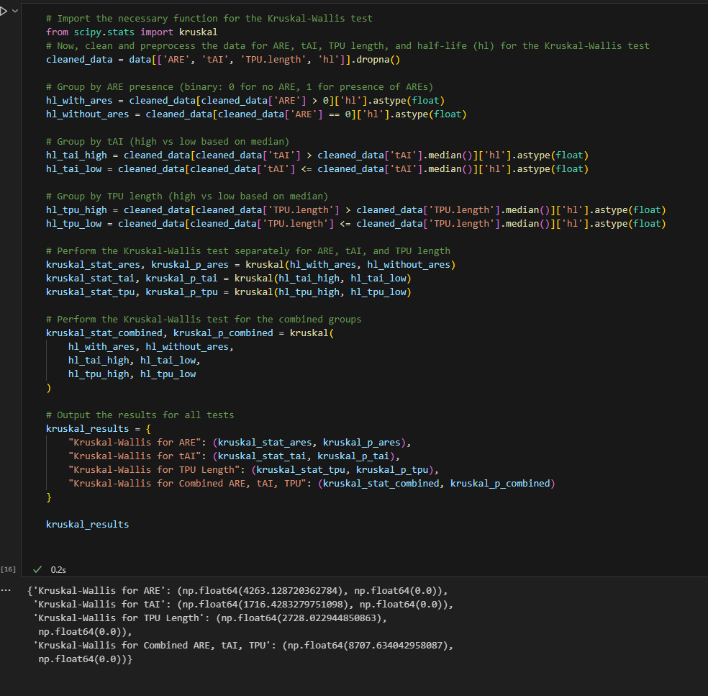
Hypothesis 4: Combined Effects of ARE , tAI, TPU length
Here are the results from the Kruskal-Wallis test for the effects of ARE, tAI, and TPU length, both separately and combined:
ARE:
Kruskal-Wallis Statistic: 4263.13
p-value: 0.0
Interpretation: There is a statistically significant difference in mRNA half-lives between genes with and without AREs.
tAI:
Kruskal-Wallis Statistic: 1716.43
p-value: 0.0
Interpretation: There is a statistically significant difference in mRNA half-lives between genes with high and low tAI values.
TPU Length:
Kruskal-Wallis Statistic: 2728.02
p-value: 0.0
Interpretation: There is a statistically significant difference in mRNA half-lives between genes with high and low TPU lengths.
Combined ARE, tAI, and TPU Length:
Kruskal-Wallis Statistic: 8707.63
p-value: 0.0
Interpretation: The combined effect of ARE, tAI, and TPU length on mRNA half-life is statistically significant.
All tests show significant differences, indicating that ARE, tAI, TPU length, and their combined effect influence mRNA stability.

Slide 22
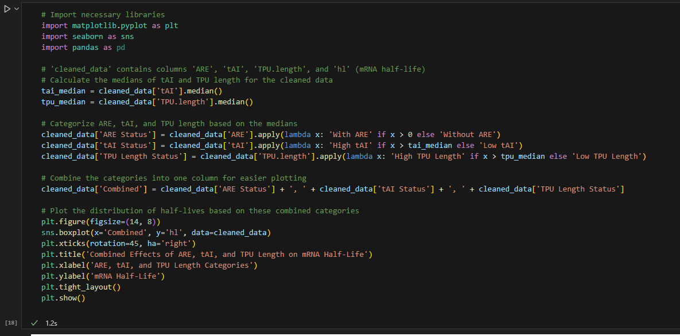
Hypothesis 4: Combined Effects of ARE , tAI, TPU length

Slide 23
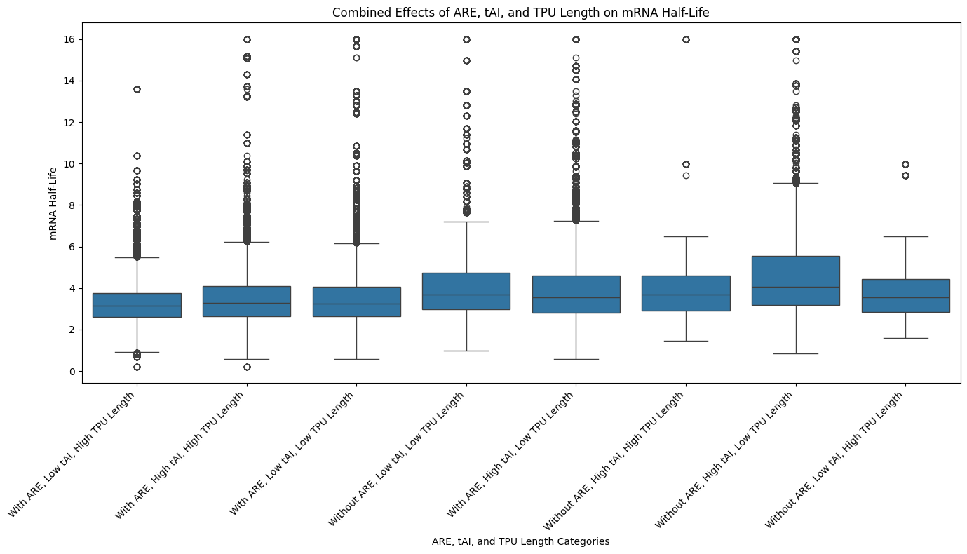
Hypothesis 4: Combined Effects of ARE , tAI, TPU length

Slide 24
Result of Statistical Tests
Each parameter contributes to the overall value of a gene's half-life, with some factors having a positive effect, increasing half-life, while others have a negative effect, reducing it.
Focusing on only a few parameters may lead to inaccurate conclusions. By incorporating more parameters into the analysis and using a larger dataset, the results become more robust and reliable.
The final test was decisive: before this comprehensive analysis, the individual significance of each parameter on half-life was unclear. However, by considering all parameters together, it became evident that there is a clear correlation between them and half-life. These findings could inform future models to predict half-life based on these variables and, potentially, manipulate them genetically to alter half-life.
Running a predictive model helps us take this analysis a step further by enabling the estimation of half-life based on key parameters like ARE, m6A enrichment, tAI, and TPU length. A well-trained predictive model can not only offer insights into the current data but also serve as a tool for future predictions. By accurately predicting half-life from gene features, we could optimize biological experiments and potentially influence gene expression outcomes, aiding in genetic or therapeutic interventions.

